Slide 1


etflix
Dataset Analysis
Utilizing Python Libraries for Data Exploration
-By Shweta Shaw

Slide 2


Introduction
This project focuses on analyzing Netflix dataset , focusing on various data analysis techniques using Python functions and libraries

Slide 3



Objectives
Load and clean the Netflix dataset
Understand the dataset’s structure
Perform exploratory data analysis (EDA)
Drive Strategic Decision-Making
Scope
This project analyzes a Netflix dataset , using python and Pandas to explore and gain insights into its structure and content

Slide 4



Workflow
Data Collection and Loading
Data Cleaning and Transformation
Data Storage and Management
Data Analysis and Insights

Slide 5
Data Collection and Loading
Data Sources
Netflix dataset containing information about movies, TV shows, directors, cast, genres, countries, duration, and ratings.
Data Loading Process
Data is loaded into a Pandas Data frame using pd.read_csv () after importing the Pandas library in Python.

Slide 6


DATA CLEANING

Slide 7
Enhancements in Netflix Data Set
Identify missing values using the is null() function
Remove rows with missing data using the dropna() function
Delete duplicate records with the duplicate() function
Remove duplicates using the drop_duplicates() function
Filter and group data using functions like str . contains (), isin(), and group by()
Create new columns and filtered Data Frames as needed for analysis.
Ensure data quality before moving on to visualization and further exploration.

Slide 8

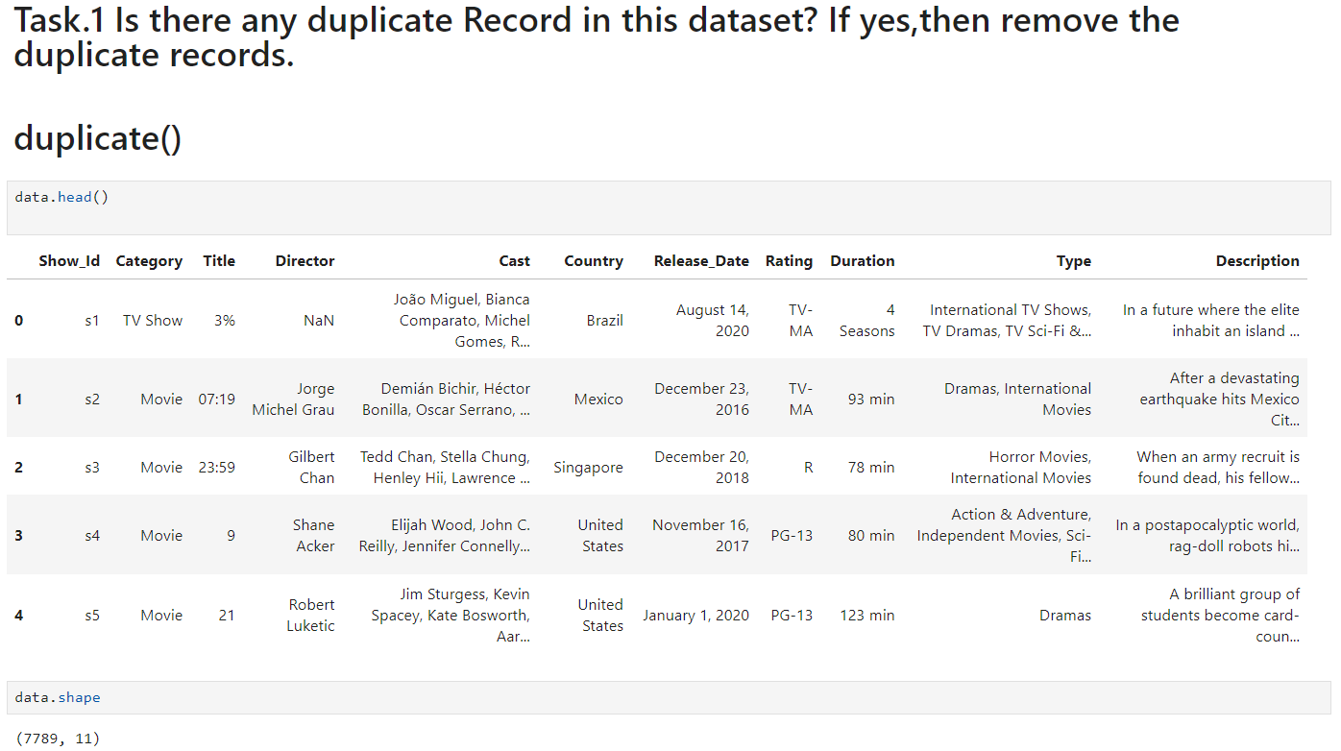
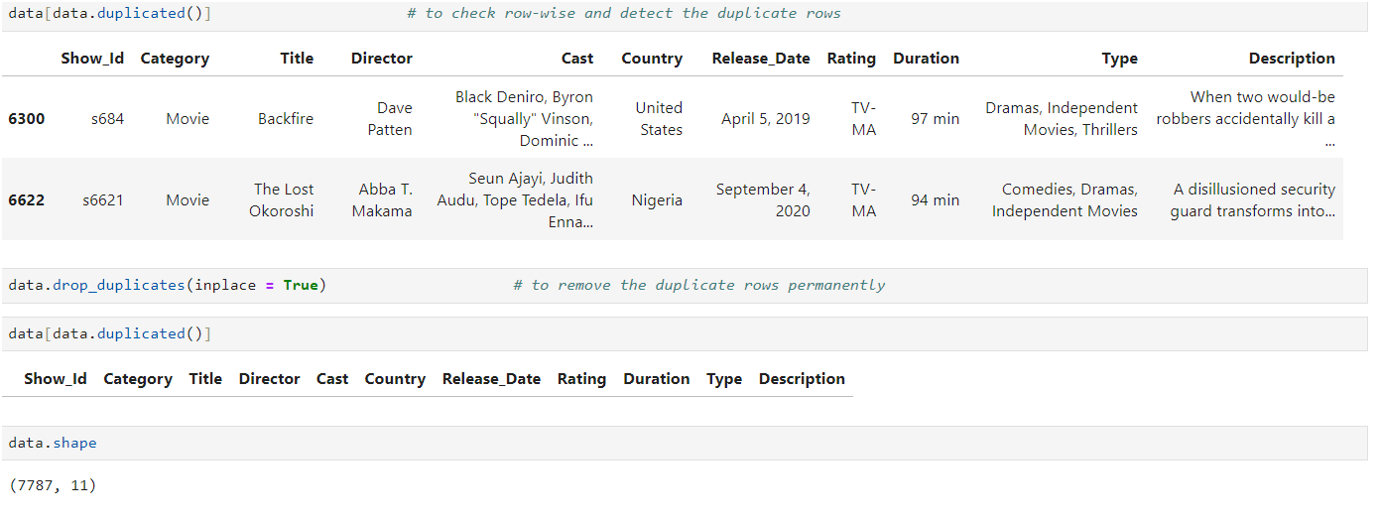
DATA CLEANING

Slide 9
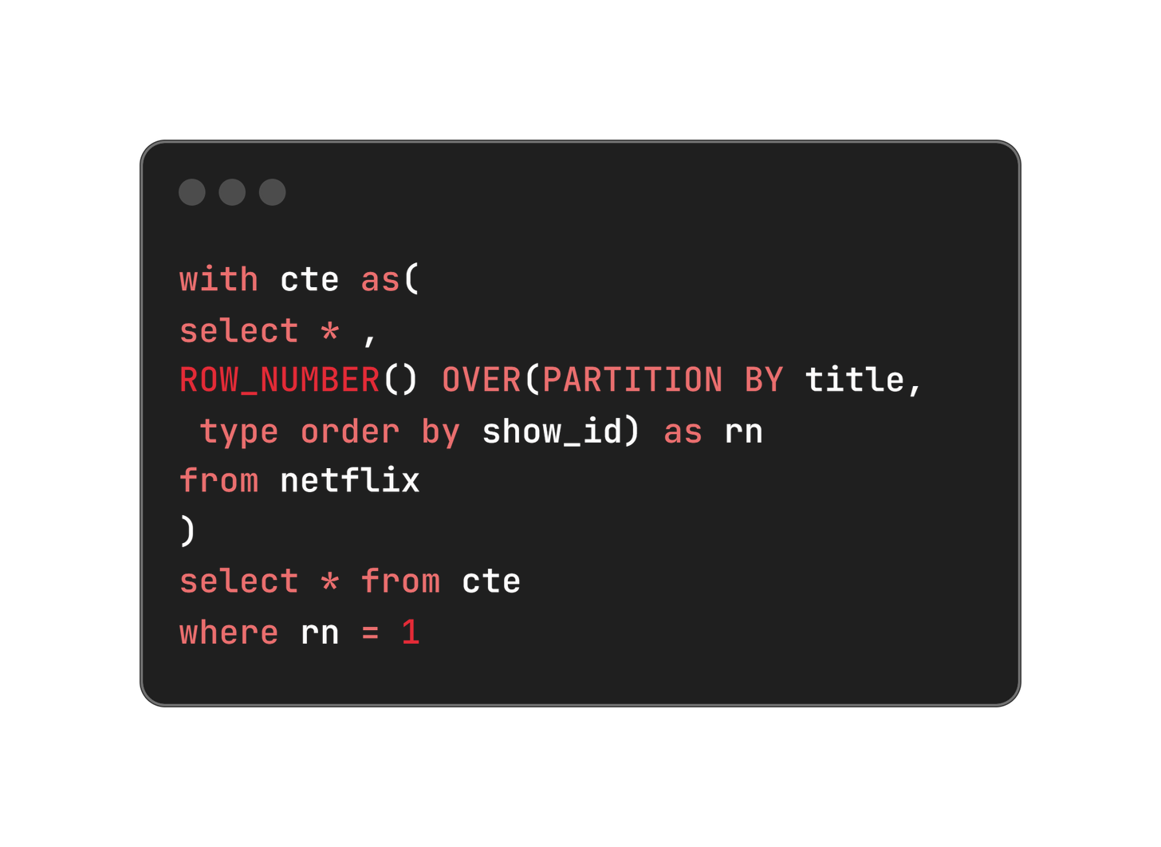
2. Remove Duplicates
This SQL query efficiently selects only unique rows for each title in the Netflix data table by assigning row numbers partitioned by title, thereby ensuring duplicates are handled appropriately.

Slide 10
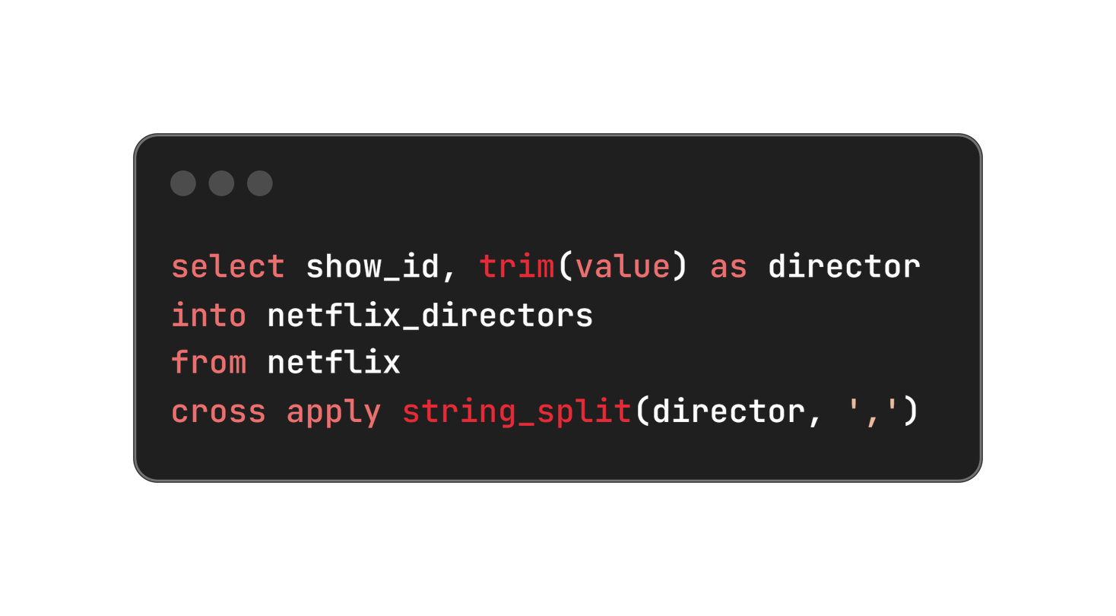
3. Refactoring Columns with Multiple Values into Separate Tables
To improve data structure and normalization, columns containing multiple values separated by commas were refactored into separate tables. This enhances data integrity and allows for more efficient querying and analysis of individual values.

Slide 11
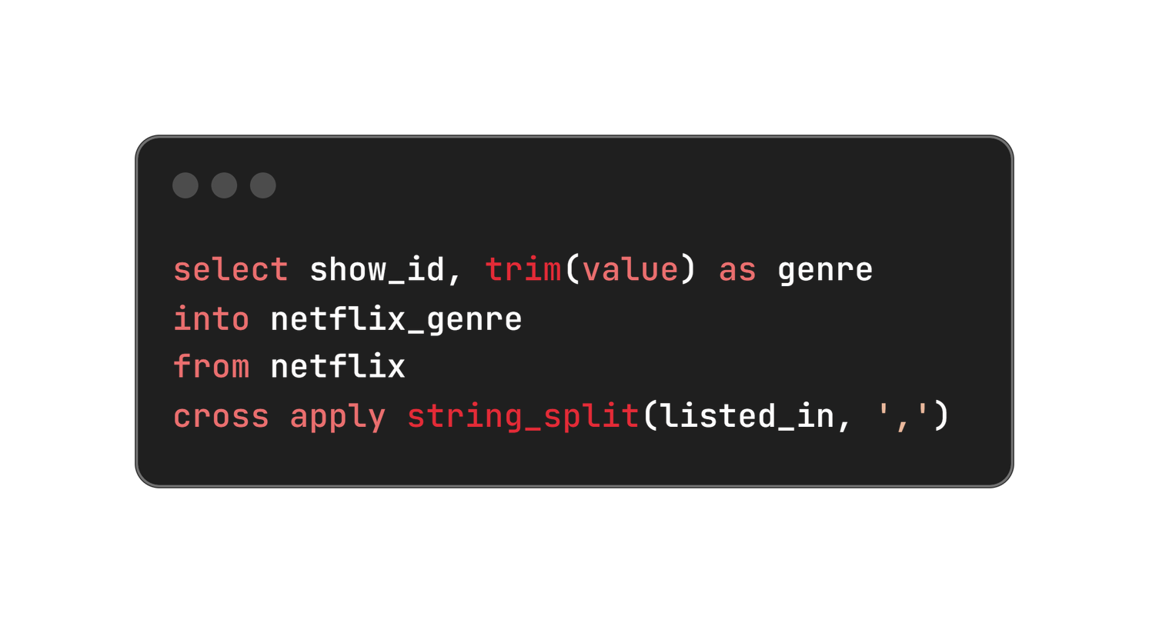
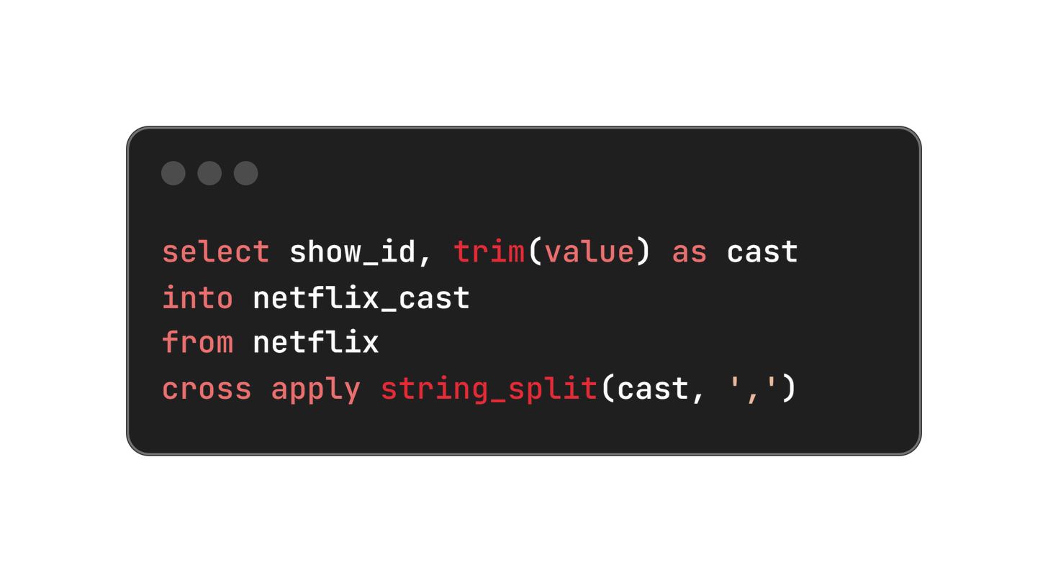
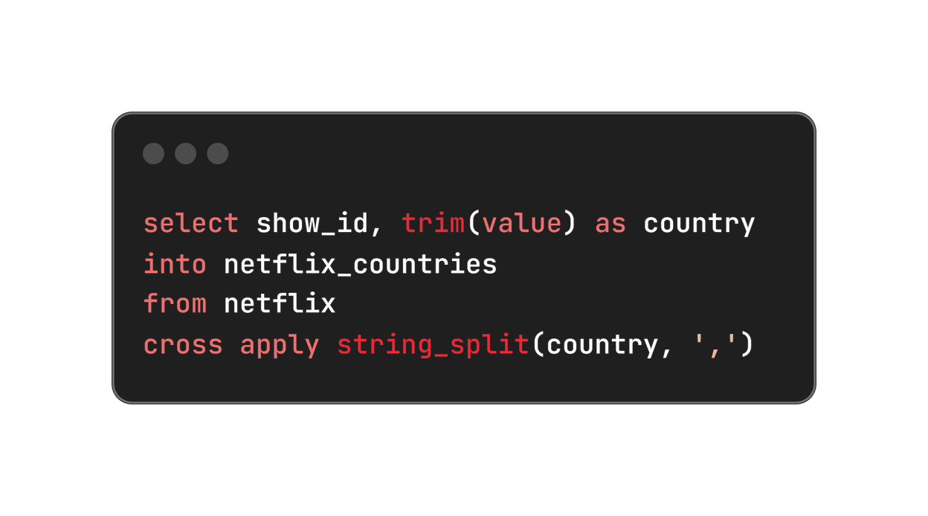

Slide 12
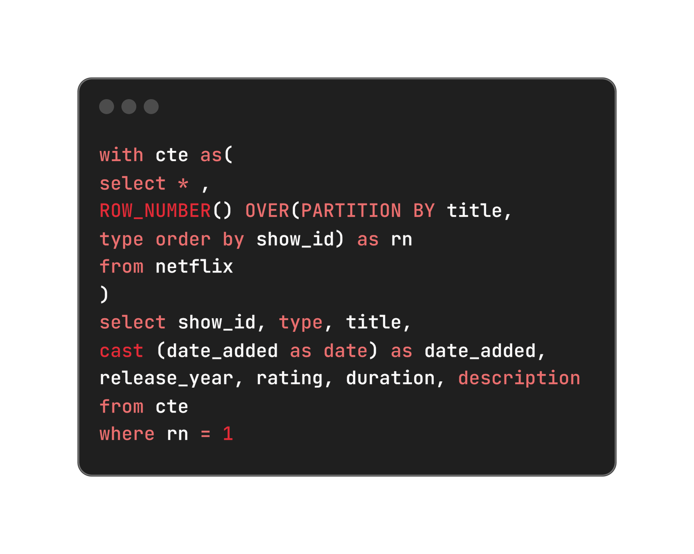
4. Data type conversions for date added
The data type of the "Date Added" column was changed from varchar to date to enhance data consistency and facilitate accurate date handling.

Slide 13
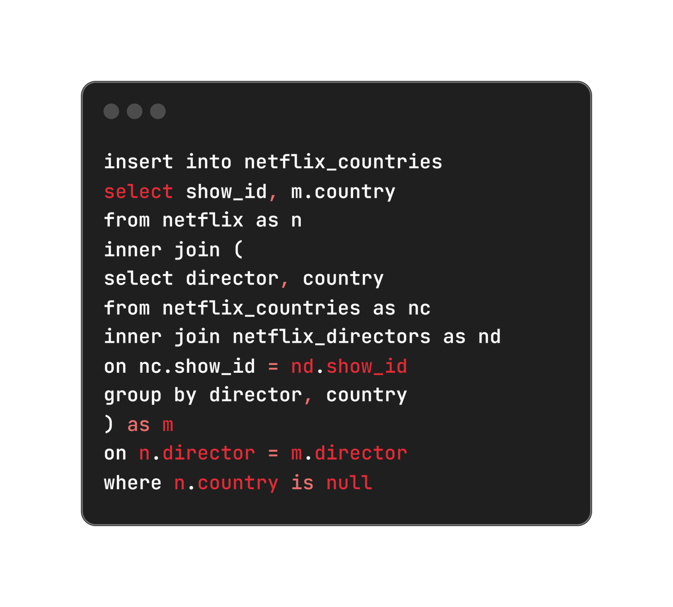
5. Populating missing values in Country Column
Null values in the "Country" column were filled by analyzing the "Director" column, assuming that directors typically create content in their own country.
This approach improves data completeness and enhances geographical insights within the dataset.

Slide 14
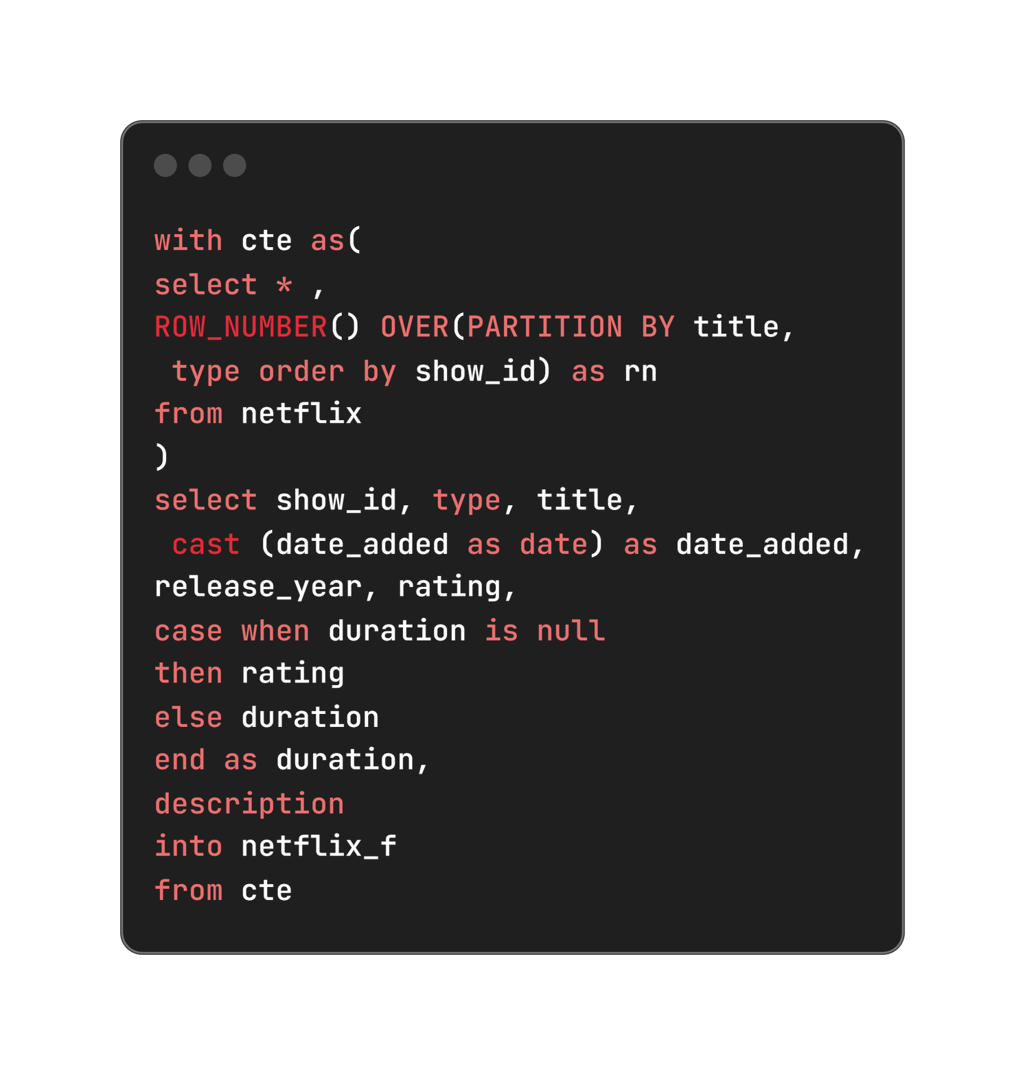
6. Populating missing values in Duration Column
An issue was identified where null values in the "Duration" column were incorrectly placed in the "Rating" column. This discrepancy was resolved using a ‘CASE’ statement, ensuring that each column contains the appropriate data without compromising data integrity or analysis accuracy.

Slide 15
DATA ANALYSIS

Slide 16
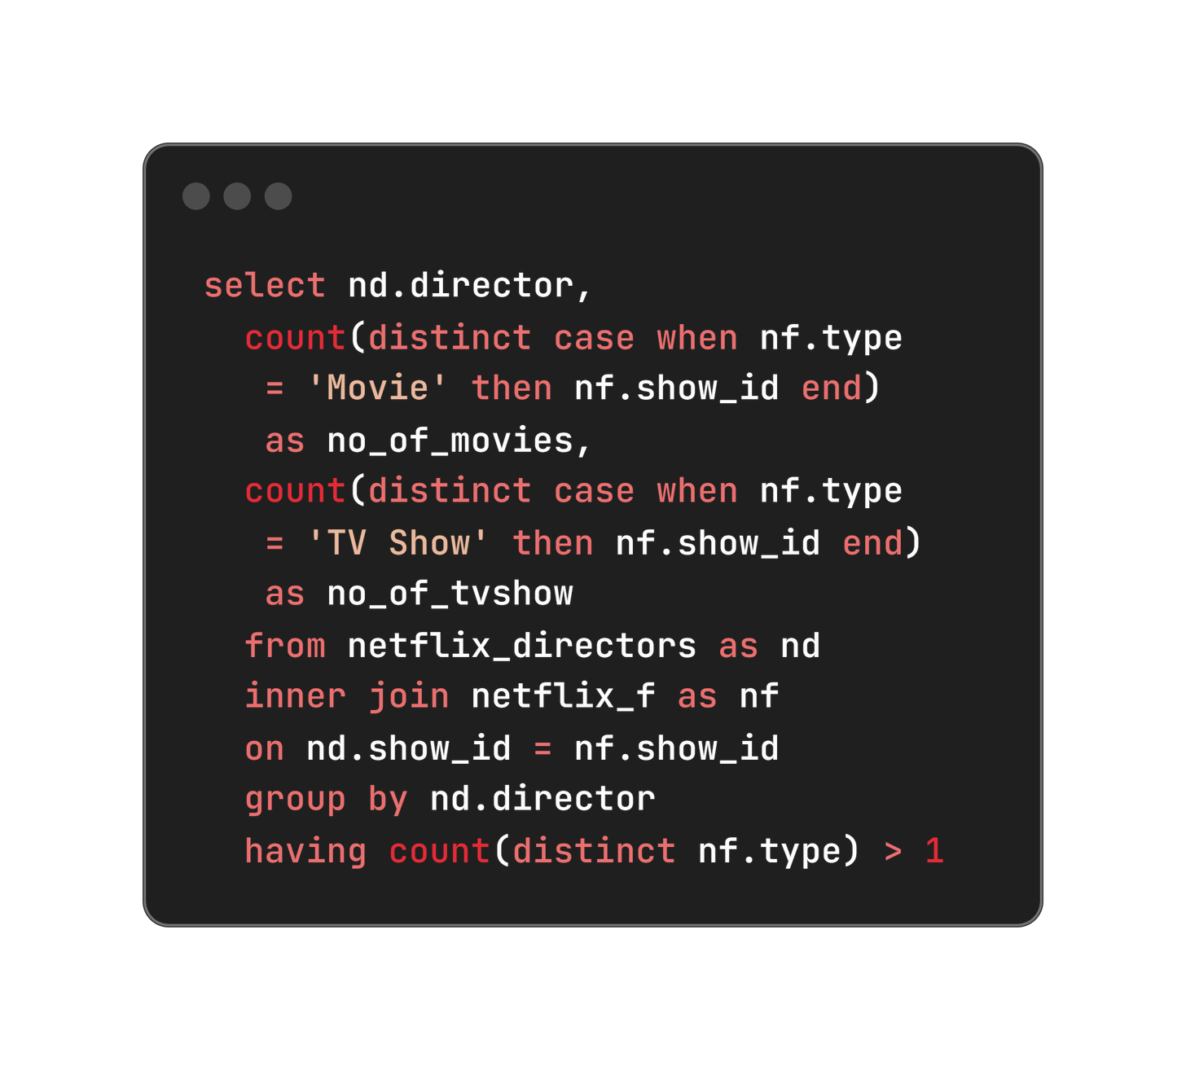
For each director count the number of movies and tv shows created by them in separate columns for directors who have created tv shows and movies both

Slide 17
Top 6 rows of the Output table
Director | No. of Movies | No. of TV Shows
Abhishek Chaubey | 4 | 1
Alastair Fothergill | 1 | 3
Alban Teurlai | 1 | 1
Alessandro Angulo | 1 | 1
Andrew Tan | 1 | 1
Anurag Kashyap | 8 | 1

Slide 18
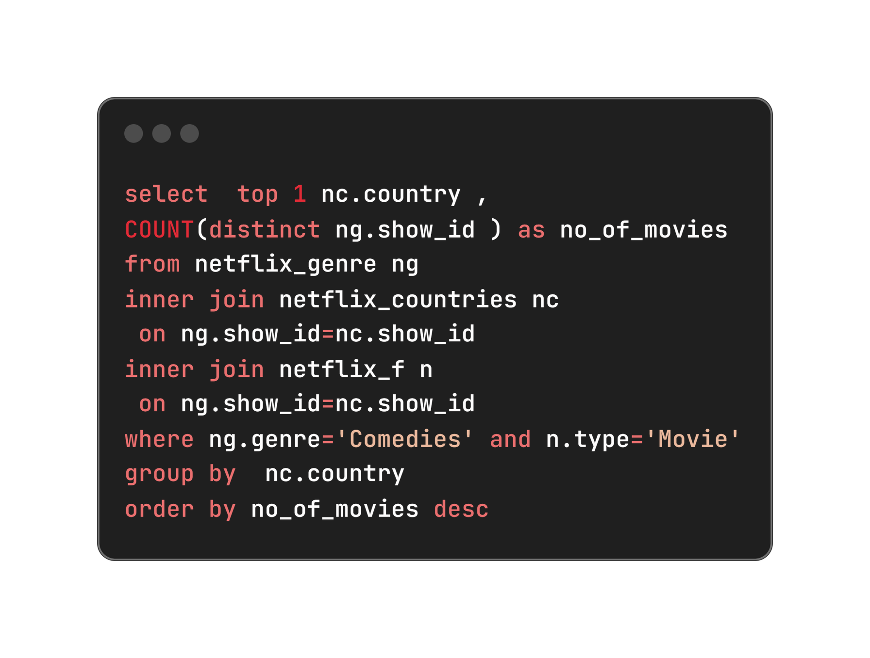
2. Which country has highest number of comedy movies
Country | No. of Movies
United States | 685

Slide 19
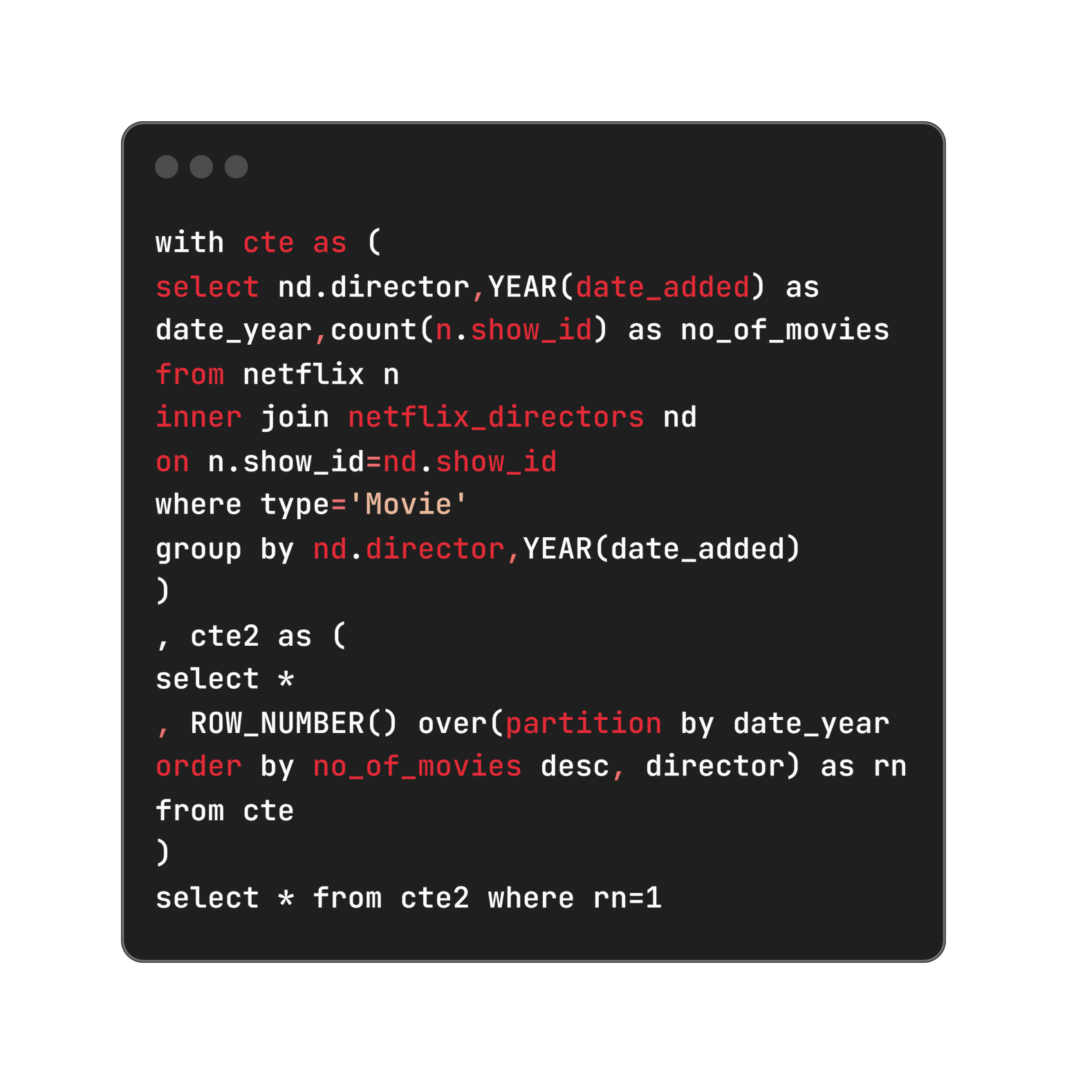
3. For each year (as per date added to netflix), which director has maximum number of movies released

Slide 20
Last 6 rows of the Output table
Director | Year | No. of Movies
Jan Suter | 2016 | 4
Jay Chapman | 2017 | 7
Jan Suter | 2018 | 12
Cathy Garcia-Molina | 2019 | 7
Youssef Chahine | 2020 | 11
Rajiv Chilaka | 2021 | 17

Slide 21


Directors with highest number of movies in respective year

Slide 22
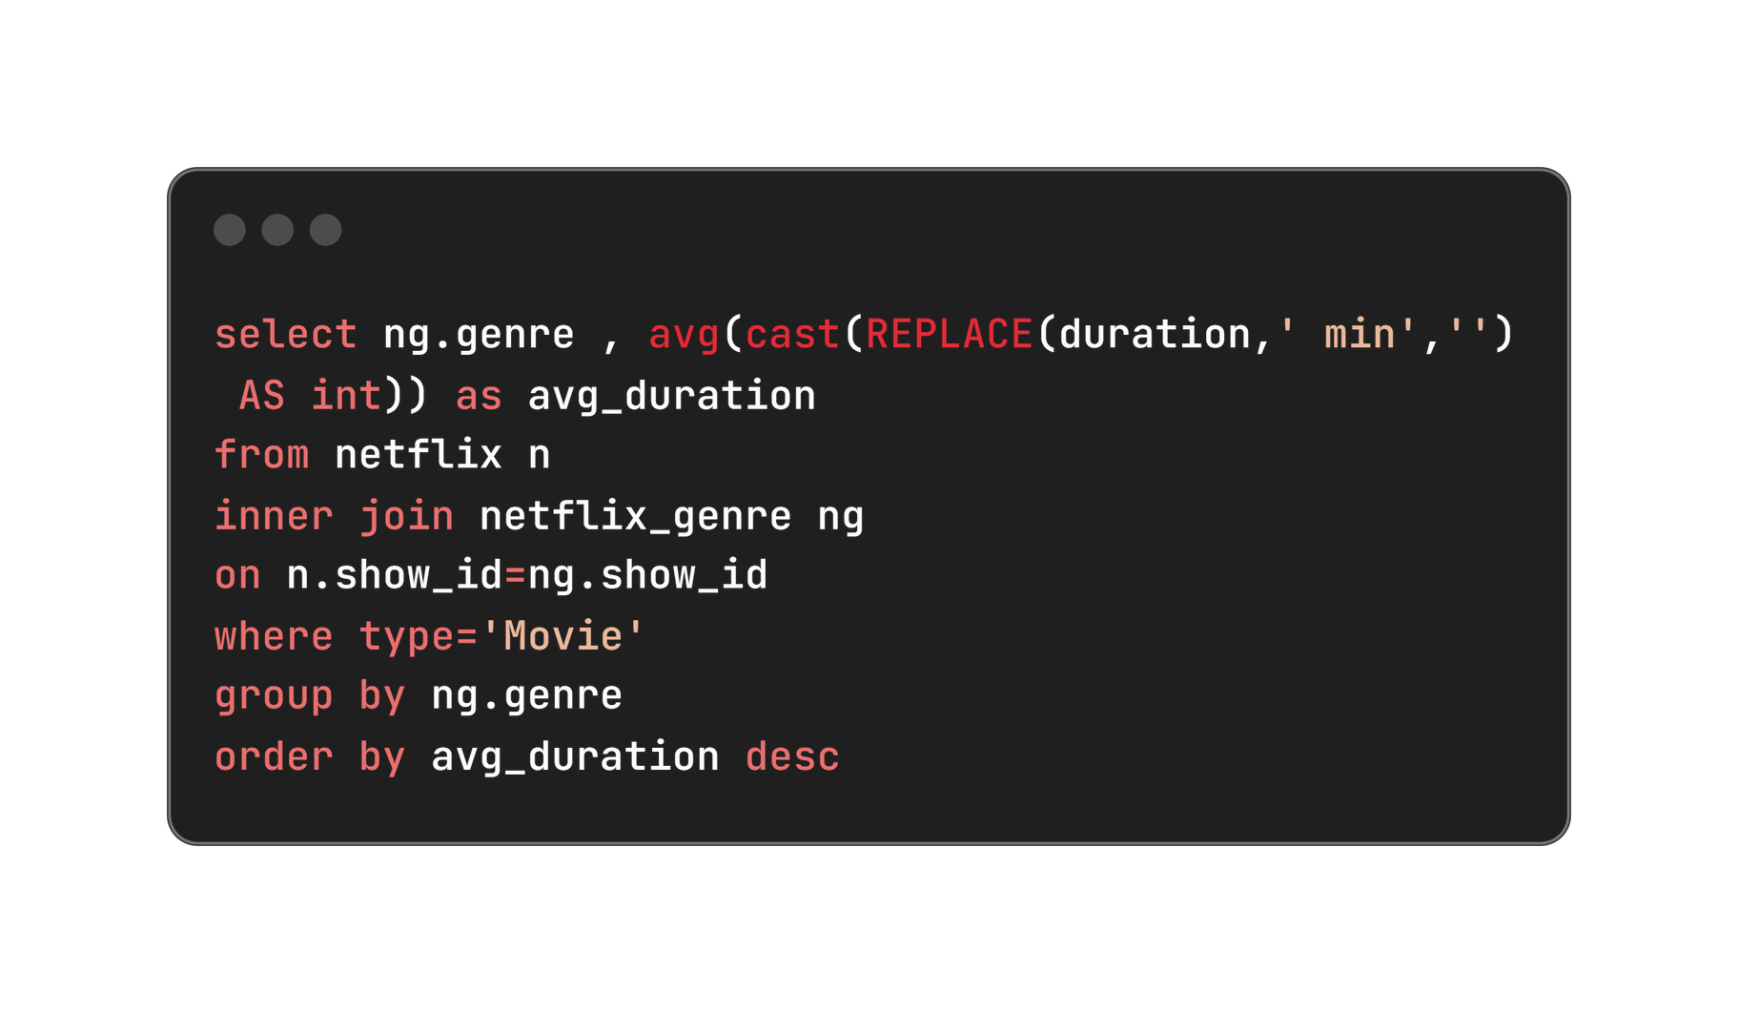
4. What is the average duration of movies in each genre

Slide 23

Top 5 movies with highest average duration time in minutes

Slide 24
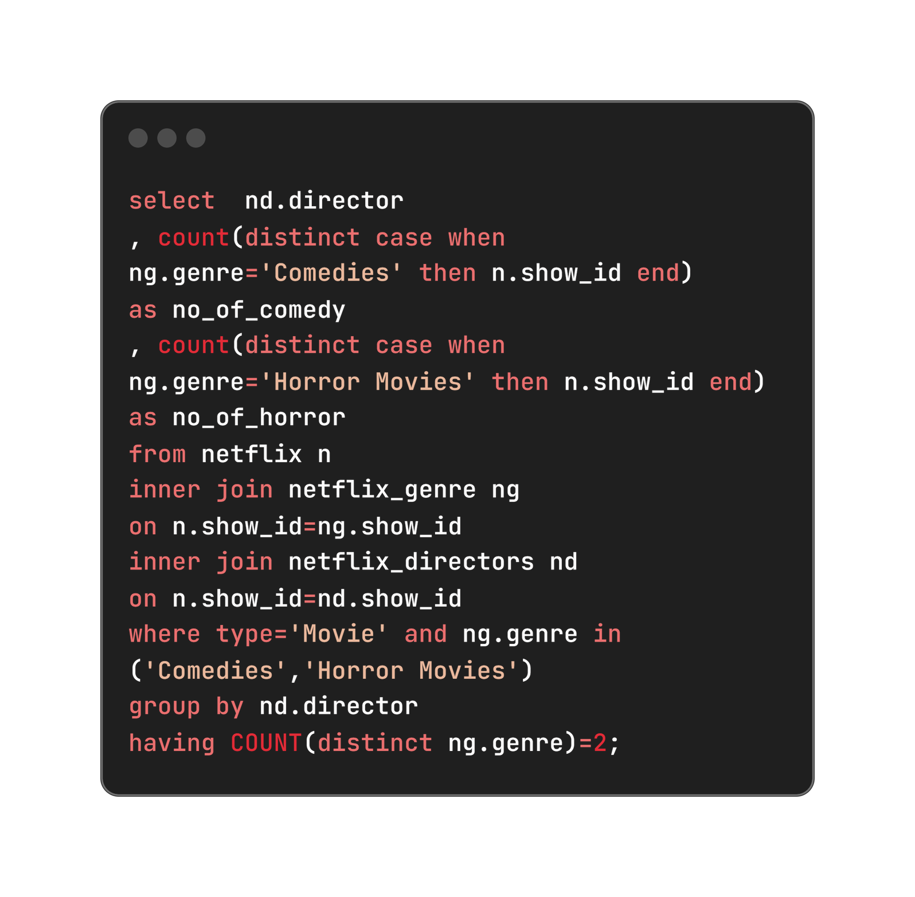
5. Find the list of directors who have created horror and comedy movies both.
Display director names along with number of comedy and horror movies directed by them.

Slide 25
6 random rows from the output table
Director | No. of Comedy | No. of TV Horror
Banjong Pisanthanakun | 1 | 3
Don Michael Paul | 3 | 3
Jeff Baena | 2 | 1
Kevin Smith | 5 | 3
Michael Tiddes | 4 | 2
Poj Arnon | 3 | 5

Slide 26
Insights and Results

Slide 27
Key Findings
Content Preferences: Highlighted the popularity of comedy movies in the United States, guiding localized content acquisition strategies.
Directorial Excellence: Recognized prolific directors and their impact on Netflix’s content diversity and viewer engagement.
Genre Analysis: Provided insights into viewer preferences based on genre and average duration, informing content curation strategies.

Slide 28
Business Impact
Enhanced Content Relevance:
Targeting popular genres like comedy in the United States improves viewer engagement.
2. Strategic Partnerships
Collaborating with top directors diversifies content and attracts broader audiences.
3. Operational Efficiency
Optimizing content length enhances viewer satisfaction and retention.
4. Informed Decision-Making
Data-driven insights enable precise resource allocation and competitive positioning.

Slide 30

Thank you!
For exploring this presentation on the Netflix data analysis project. Your interest and engagement are greatly appreciated as we continue to uncover valuable insights from the data.

